Slide 1
Using DCAF to expand a CVT Application
Benjamin Celis

Slide 2
Agenda
Initial Code
New architecture design
Adding the Engine
Configuring TBDF
Deploying Application

Slide 3
Initial Code
High Speed Acquisition Loop
Processing and getting Tag Values
Sharing the Tag Values on CVT
Need to work publish and log this Results
Data Acquisition Loop
Processing Loop
CVT
Publishing loop ??

Slide 4
Code Snippet

Slide 5
Communication Diagram
Code with CVT
CVT
Tag Bus Engine
Modbus Module
TDM Module

Slide 6
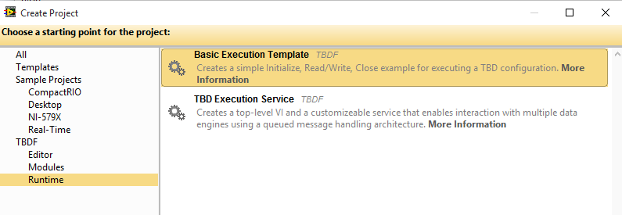
Adding the Engine
Project>> Create Project …
Select Simple Runtime engine
Create them in a temp directory

Slide 7
Making sure the dataflow is the correct

Slide 8
Configure System
Open Default Configurator editor
Tools>>TBDF>> Launch Standard Configuration Editor
Add target
Add Engine
Add Tags
Add CVT Module
Add TDMS Module
Save Configuration
Script the Include File
Deploy Configuration

Slide 9
Execute Code

